Slide 1

2025 QA Portfolio Executive Review
VERIFIX • GOAML • CITICONNECT • TRADELENS • GLOBAL KYC
Strategic Performance & Compliance Impact

Slide 2





2025 Strategic Outcomes
5
2,102
177
0
MAJOR PROJECTS DELIVERED
TOTAL TEST SCENARIOS
DEFECTS PRE-EMPTED
PRODUCTION ISSUES
Executive Impact
100%
Successfully navigated 2025's regulatory shifts with zero defect leakage. Unified 5 disparate testing streams into a cohesive, AI-augmented quality assurance framework.
Regulatory Compliance

Slide 3
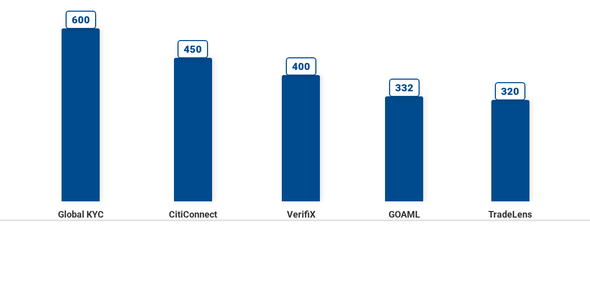
Execution Volume by Initiative
* Data reflects total validated scenarios across Functional and Regression cycles

Slide 4









AI & Automation Strategy
TIME SAVINGS
40%
AI TEST CASES
100
Leveraging GenAI to shift left and accelerate delivery cycles.
AI SCRIPTS
50
CHALLENGES & LEARNINGS
Fine-tuning prompts for complex logic and overcoming Excel parsing limits remain key focus areas for 2026.
Friday.AI Prompt Engineering
Copilot Test Script Gen

Slide 5







VerifiX Application
FUNCTIONAL CASES
400
BUSINESS IMPACT
Eliminated manual reporting errors, ensuring 100% adherence to FinSurv mandates.
REGRESSION CASES
170
Remediation of non-compliant reporting matters to ensure zero risk exposure.
AUTOMATABLE
100
AUTOMATED
60
DEFECTS
50
Automated Payment ID
Zero Prod Issues

Slide 6

GOAML Integration
FUNCTIONAL CASES
332
BUSINESS IMPACT
Optimized transaction reporting speed, reducing regulatory submission lag.
REGRESSION CASES
140
Boosting Straight-Through Processing (STP) rates for critical transaction reports.
AUTOMATABLE
80
AUTOMATED
42
DEFECTS
35
Increased STP Efficiency
Complex Logic Validation

Slide 7

CitiConnect API
FUNCTIONAL CASES
450
BUSINESS IMPACT
Enhanced institutional client experience with sub-second API validation.
REGRESSION CASES
200
Overhauling legacy API gateways to reduce latency and ensure real-time payload checks.
AUTOMATABLE
180
AUTOMATED
144
DEFECTS
25
40% Latency Reduction
Copilot Unit Tests

Slide 8


TradeLens Ledger
FUNCTIONAL CASES
320
BUSINESS IMPACT
Secured immutable audit trails for high-value trade settlements.
REGRESSION CASES
100
Validating distributed ledger technology for smart contract integrity.
50
AUTOMATABLE
AUTOMATED
20
DEFECTS
12
Smart Contract Logic
Secure Settlement

Slide 9

Global KYC Unification
FUNCTIONAL CASES
600
BUSINESS IMPACT
Unified global identity standards, reducing client onboarding time by 30%.
REGRESSION CASES
300
Merging APAC and EMEA customer datasets with AI-driven duplicate detection.
AUTOMATABLE
250
AUTOMATED
188
DEFECTS
55
Dataset Merge
AI Deduplication

Slide 10








2026 Strategic Vision
SELF-HEALING SCRIPTS
CLOUD-NATIVE TESTING
SECURITY-FIRST QA
PREDICTIVE ANALYTICS
Moving beyond defect detection to defect prevention. Our 2026 roadmap integrates advanced AI agents to predict failure points before code deployment.

Slide 11
Q & A
THANK YOU FOR YOUR ATTENTION
2025 QA Leadership Team

